Slide 1
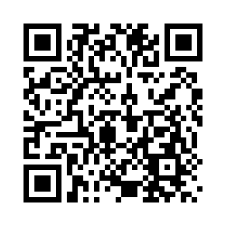
Version 1: 12.1.23
Co-production of a Web-Based Implementation Toolkit Project
Are you an academic, researcher, manager, doctoral student, postdoctoral fellow or public contributor?
Does your role involve implementing research outputs (e.g. introducing new interventions/ innovations and/or changes in practice)?
Researchers from the School of Health Sciences, University of Southampton/NIHR ARC Wessex would like you to test an innovative web-based implementation toolkit:
www.implementationtoolkit.org.uk
Please provide feedback via a short survey:
https://southampton.qualtrics.com/jfe/form/SV_agSbjiPV7TQhD26
Or
If you have any questions please email: Cindy Brooks at: C.F.Brooks@soton.ac.uk
This study has been approved by the University of Southampton Research Ethics Committee (ERGO Ref:68858).
Thank you.

